Slide 1
the SuperTicket
A Great Fundraiser for your Next Event!
LeaderBoard of Boston
Nick Richard
Manager of Events

Slide 2
The superticket
Your Cost is $10 per SuperTicket
Sell for a minimum of $40 and NET $30 profit
Offer as an Option at registration
Typically 70% or more will opt in
50 SuperTicket Minimum Purchase, increments of 25 over the minimum
Return overage for full credit
Full field events typically raise $3,000+ NET

Slide 3
What is a superticket?
High value, bundled promotions from local and national sponsors
A proven fundraiser sold as an OPTION at registration
Fully customizable designs with content that you choose to best suit your audience.
Custom printing that features your tournament logo/branding

Slide 4
What is In a superticket?
Great content for both golfers and non-golfers
Raffle tickets & Mulligans increase profits
$100,000 Shootout for (4) Players to kick off your event
Promos from Golfsmith, Dave & Busters, JiffyLube, Warrior & more…
Add custom content through your relationships

Slide 5
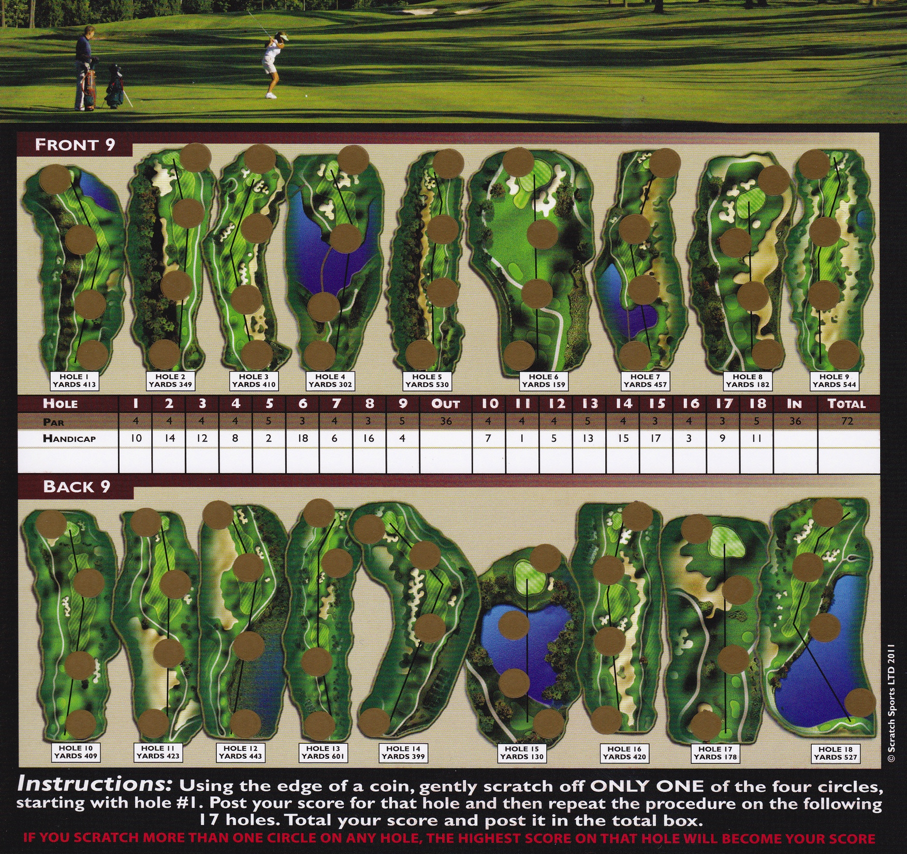
Golf Scratch Card

Slide 6
Grand Prize
Every SuperTicket includes a Golf Scratch Card with the chance to win the Grand Prize:
5 Day/4 Night stay at The Pete Dye Golf Lodge
Casa de Campo, Dominican Republic
($1,400 Value)
This is a world class resort that features the famous “Teeth of the Dog Golf Course”, ranked #1 course in the Caribbean!

Slide 7
The superticket
Your cost is $10 per SuperTicket and typically sell for a minimum of $40…NET $30 profit for each sale
Offer as a premium option at registration
Typically 70% or more will opt in
50 SuperTicket minimum purchase, increments of 25 over the minimum
Return any unsold for full credit
Full field events typically raise $3,000+ NET

Slide 8
the SuperTicket
For more information, please contact:
Nick Richard, Manager of Events
LeaderBoard of Boston
nick@leaderboardboston.com
774.254.0880

Slide 9
Thank You for your Interest!

